Slide 1


Electronics and Communication Engineering
MINOR PROJECT 1
REPORT ON
“General Parking Sensor”
Submitted By
Manoj kumar gupta 0532EC191006
Shanu Pathak 0532EC181025

Slide 2
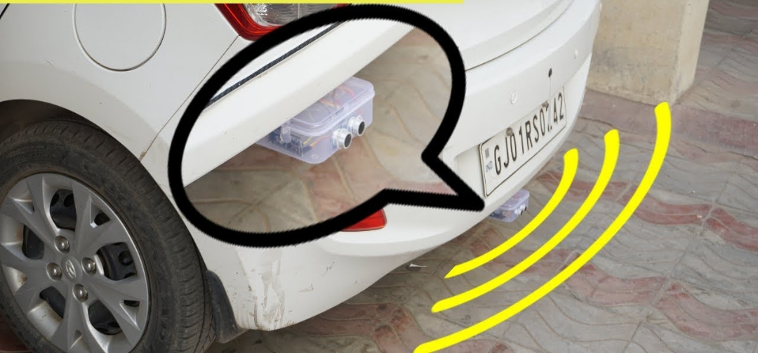
SHA SHIB COLLEGE OF TECHNOLOGY, BHOPAL
MINOR PROJECT
General Parking Sensor
Department of Electronics and Communication Engineering
SESSION: 2019-2023

Slide 3

Electronics and Communication Engineering
Submitted By
Submitted To
Manoj kumar gupta 0532EC191006 Shanu Pathak 0532EC181025
Mr. Navin Chourasia
Dept. ECE, SCT Bhopal

Slide 4
Electronics and Communication Engineering
CONTENT
INTRODUCTION COMPONENTS REQUIRED SIMULATION PRINCIPLE OF GENERAL PARKING SENSORS WORKING OF GENERAL PARKING SENSORS APPLICATION OF GENERAL PARKING SENSORS ADVANTAGE OF GENERAL PARKING SENSORS CONCLUSION

Slide 5
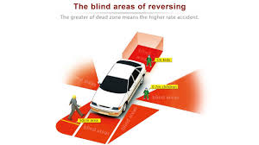
INTRODUCTION
In this project, we will build a “General parking sensors” using Arduino and Ultrasonics distance sensors.
Eventually if the car gets close to an object, the buzzer will activated automatically.
In this project, I have built a simple prototype of a Car Reverse Parking Sensor with the help of Arduino UNO and the very famous HC-SR04 Ultrasonic Sensor.

Slide 6
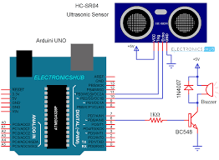
COMPONENTS REQUIRED
Arduino Uno R3
5V Active Buzzer
Jumper Wire
Ultrasonic Sensors HC-SR04
Breadboard
100 ohm Resistor

Slide 7
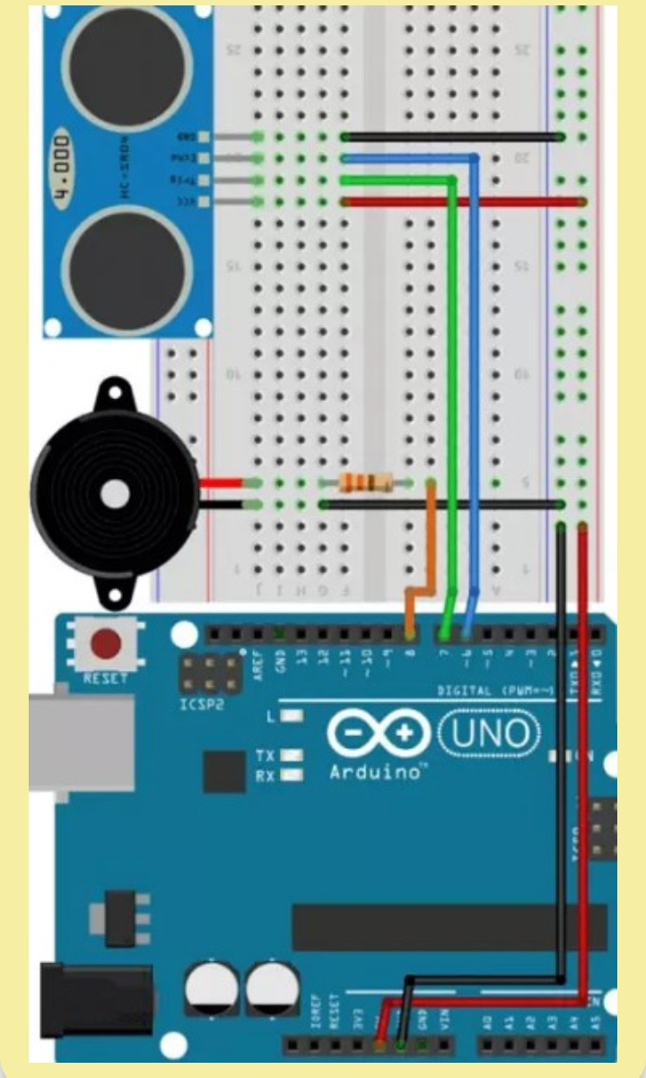
SIMULATION
The design of the Arduino Car Reverse Parking Sensor Circuit is very simple. Starting with the Ultrasonic Sensor, it has 4
pins: VCC, TRIG, ECHO and GND.The VCC and GND are connected to +5V and GND of the power supply while the TRIG and ECHO are connected to Digital I/O pins 6 and 7 of Arduino respectively.
Even though the buzzer used here is a 5V buzzer, I decided to use a driver circuit for the buzzer . I have used 100Ω Resistor (for the base) to drive the buzzer.

Slide 8
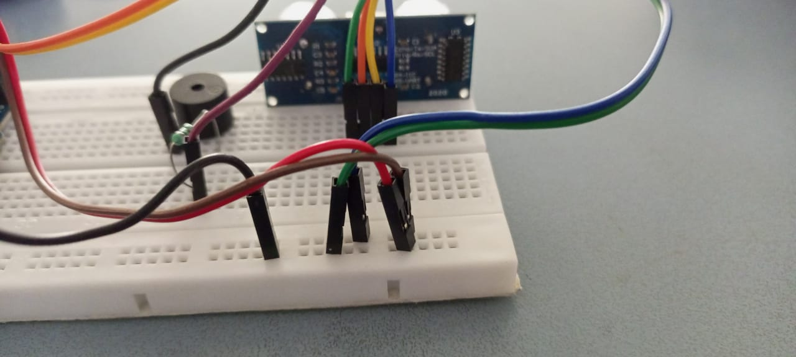
PRINCIPLE OF GENERAL PARKING SENSORS

Slide 9

As mentioned earlier, the Ultrasonic Sensor is the main unit (component) that is responsible for measuring the distance. Arduino UNO acts as the main controlling unit that will control the Ultrasonic Sensor, calculate the distance and activate the buzzer.
The principle of the circuit is as follows: The Ultrasonic Sensor sends acoustic pulses and the Arduino measures the interval of each reflected signal. Based on this time interval, Arduino then calculates the distance of the object.
Arduino then activates the Buzzer if the distance between the sensor and object is less that a certain range.

Slide 10
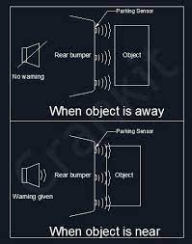
WORKING OF GENERAL PARKING SENSORS
I think the working of the project might have been very clear by now. When the circuit is powered ON, the Arduino will start measuring the distance of the objects in front of the Ultrasonic Sensor.
If the calculated distance is less than 100cm, then Arduino activates the buzzer. If you are interested, you can modify the code to beep the buzzer so that the intensity of the beeps increases with a decrease in the distance (like in a real car).

Slide 11
APPLICATION OF GENERAL PARKING SENSORS
The Arduino Car Reversing Parking Sensor Circuit can be used:
Autonomous Vehicles
Obstacle Avoiding Robots
Distance Measurement
Proximity Detection
Human Detection
Drones, UAVs and Helicopters

Slide 12
ADVANTAGE OF GENERAL PARKING SENSORS
Parking sensors help make parking easier and safer for you. Your line of sight is limited to the confines of your car. With parking sensors, you’re compensating for this lack of visibility by being able to detect obstructions and other vehicles around you.
Moreover, parking sensors help you park even in the most congested spaces. Even in low-lit or dark areas, the use of parking sensors is truly beneficial to make parking smoother and safer for you even if you can’t see what you are avoiding. Think about it as extra sets of eyes when you’re driving

Slide 13
CONCLUSION
In this project, I will design a simple Arduino Car Reverse Parking Sensor Circuit using Arduino UNO and HC-SR04 Ultrasonic Sensor. This Arduino based Car Reverse Sensor can be used for an Autonomous Navigation, Robot Ranging and other range related applications.
Almost all modern cars are equipped with reverse parking sensors that are activated when the car is put in reverse gear and beep at variable rate depending on the distance between the car and the closest obstacle

Slide 14
Thank you

